Slide 1
EXPLORATORY ANALYSIS ON HONEYPOT DATA
Subject: AIT 582
Professor : Dr. Ebrima Ceesay
Team:
Kuldip Gadapa
Satya Sai Jayanth Devineni
Yeshwanth Reddy Bommu
Vineel Vishwanth Busi

Slide 2
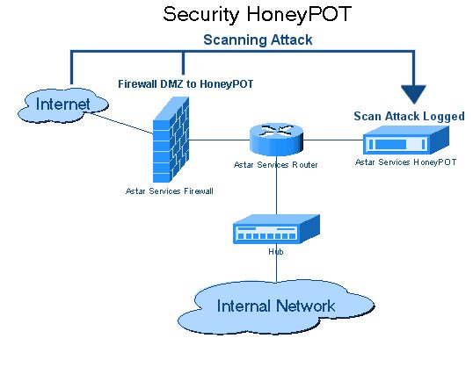
Data Capturing by Honeypot
Introduction
Problem Definition
Data Preprocessing
Data Exploration and Visualizations
Results and Conclusion

Slide 3
Introduction
Honeypot is an effective way of tackling the impact of cyberattack on computer infrastructure. It mimics a system to cause a cyberattack. It can be used to identify, deviate and know functionality of cyber criminals but it cannot stop attacks completely. They could be utilized as traps for cybercriminals as they think it is a legitimate target because it has system applications and data. AWS Honeypot resembles as Amazon network to outsiders which is maintained by Amazon IT teams. They monitor traffic for suspicious systems, track the attacks and operations to analyze what they want.
Finally, they diagnose their security measures, firewall performances and perform necessary updates. In our project, we focused on Amazon Web Services (AWS) honeypot attack data and visualizing those cyberattacks. This data is the output file of AWS honeypot system.

Slide 4
Problem statement
Host data prediction by cyber professionals in upgrading the honeypot tools and mechanisms. This research helps us to analyze and explore the cyber attacks caused on honeypots and take necessary actions to avoid such practices.
The aim of this study is to handle the growth of cybercrime by studying the attacker's behaviors and observe the drawbacks in the hosts that are frequently attacked.
As a result the organizations can avoid the hackers to break the system and save data loss.
The problem process is to identify malicious activity that organizations tend to fortify. As honeypot has no production data or don’t participate in legitimate traffic on your network and that is how we can record and identify cybercrime.
However, once the honeypot is detected its value diminishes and it is used by spamming industries to identify spam catching honeypots.

Slide 5
Data Description
Our dataset contains the attack data of the Amazon web services (AWS) containing the following data which include datetime, host, src, proto, type, spt, dpt, srcstr, cc, country, locale, localeabbr, postal code, latitude and longitude.
Using this dataset, we can analyze and predict the following which includes the geolocation of the attacked places, presenting the top attackers, detecting attacks by the host, and highly active IP addresses.
This raw data will be then processed into a CSV file containing refined data about AWS honeypot. The dataset will have 45,581 rows and 15 attributes.
Data Source: https://www.kaggle.com/casimian2000/aws-honeypot-attack-data

Slide 6
Research Questions
1. Which locations are mostly prone to cyber attacks and what do they aim for? 2. The most common timings of attack and IP addresses that are significant to attack?
3. Which protocol type is most used by attackers?
4. Are they any interesting Insights in the data and what are the maximum observations?
5. What is the significance of the relationship between the variables?
6.Time and location analysis specific to the host data?

Slide 7
Data Pre-processing
Tools Used: RStudio, KNIME Software
The Dataset 88,000 missing values in overall column fields in which we omitted the NAN and Null values.
There are columns like type, country code, locale, postal code , and X that cannot be used as they has very few observations and most of them have potential outliers.
Then the fields that were having high significance are chosen and all the null observations have been omitted.
We have filtered and grouped the geographical coordinates i.e. Latitudes and longitudes. Using the lubridate library we have organised the date structure.
We have organised the affected port sources country wise and factorised all the fields.
We have then gathered all the frequent occurring IP addresses’ source and added a column that gives the count of its occurrence in each country.

Slide 8
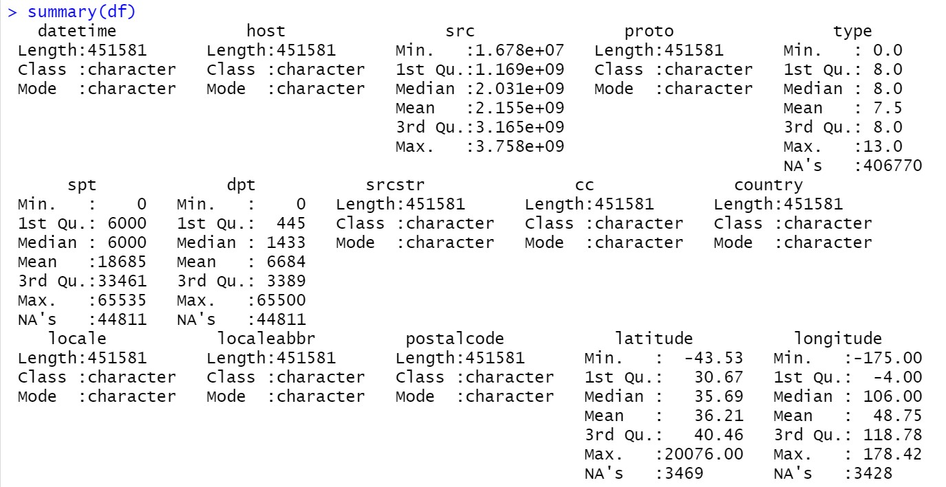
Summary of Original Dataset

Slide 9
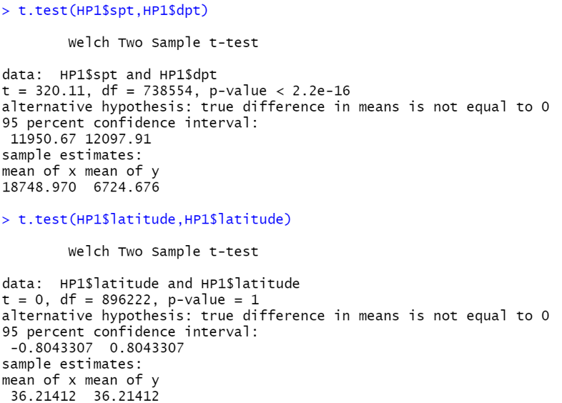
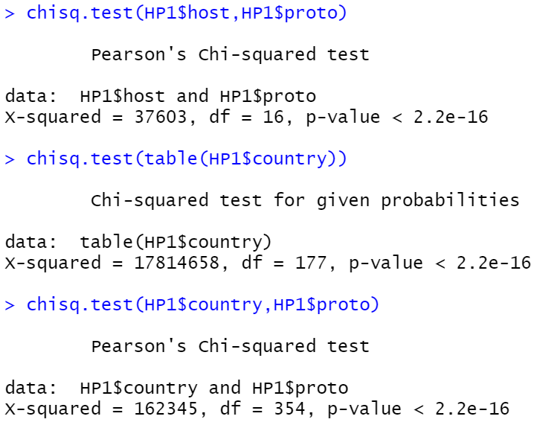
Hypothesis tests for prediction(relation fit)

Slide 10
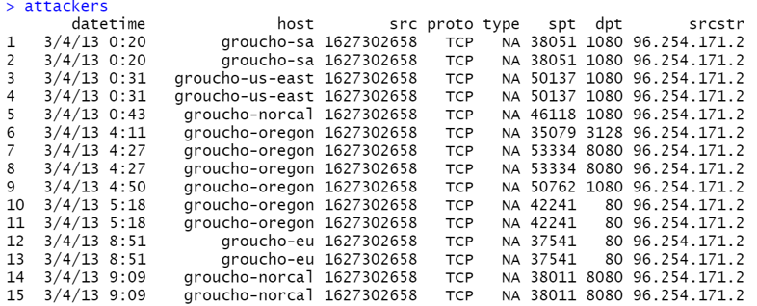
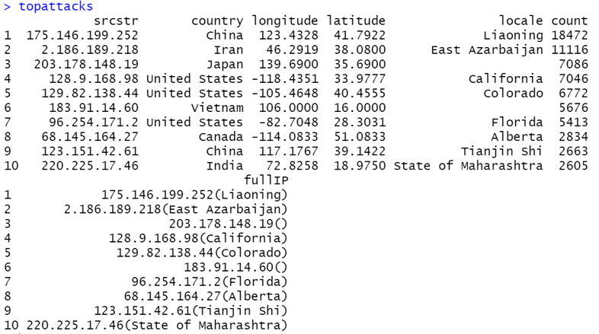
Attackers Insights(Top Attacker's fields)

Slide 11
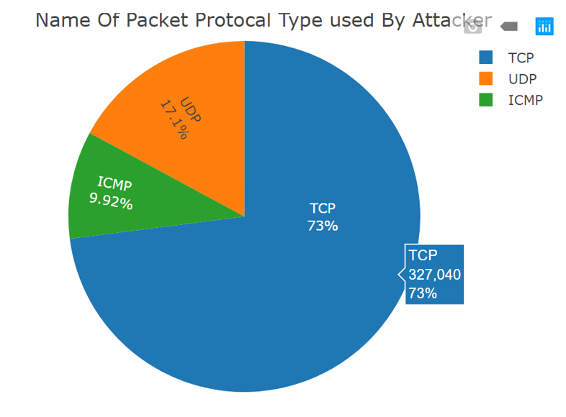
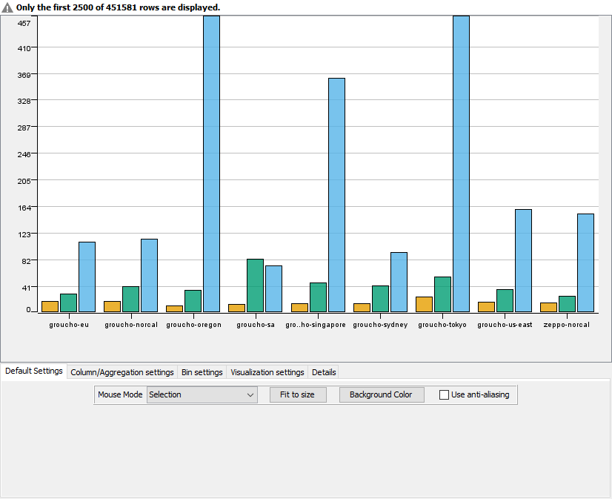
Visualizations and Analysis
Interactive Histogram for hosts differentiated by protocols

Slide 12
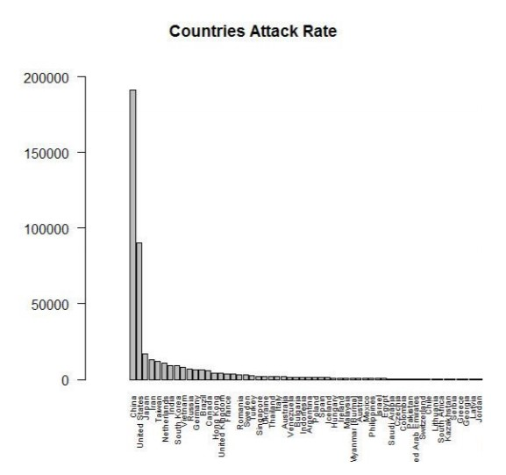
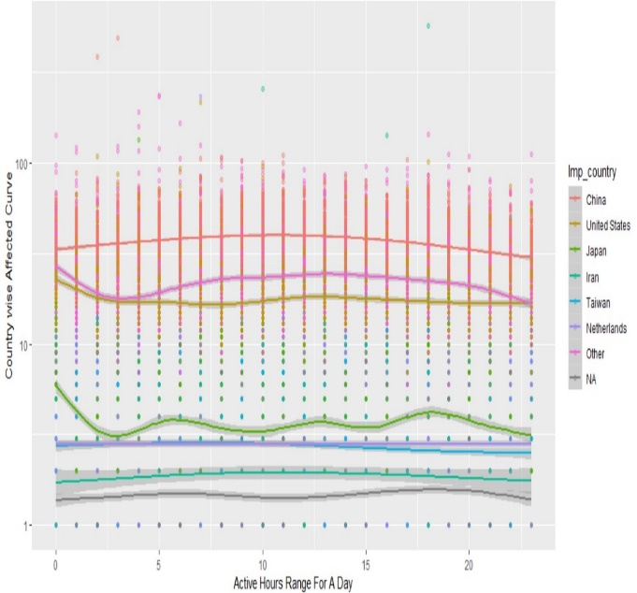
Country wise Cyber Attacks
Number Of Attacks on hosts In every Country
Sample Country wise Attacks In a day

Slide 13
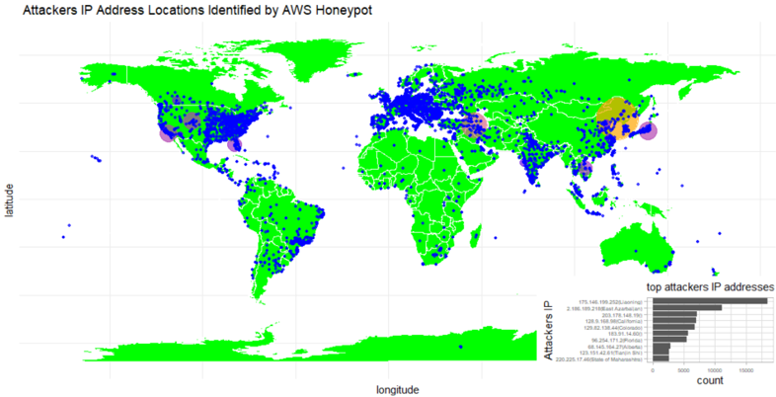
Worldwide Cyber Attacks -Top IP Addresses

Slide 14
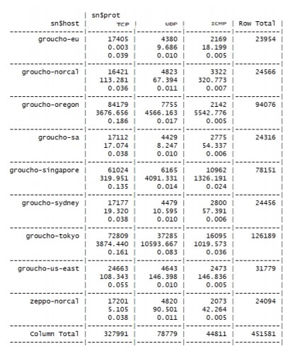
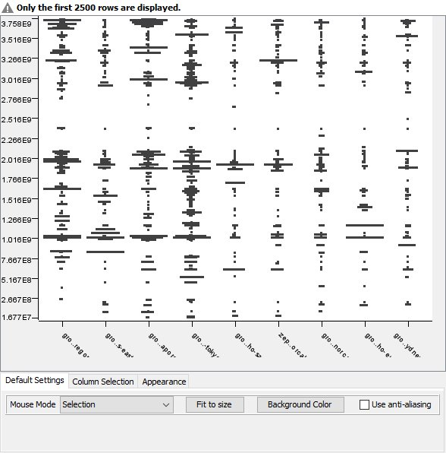
Host wise Analysis using Cross tables and Scatterplot

Slide 15
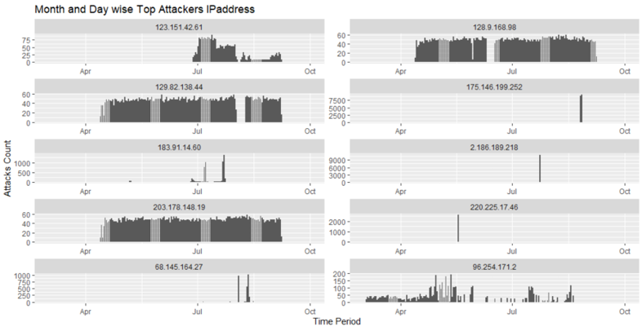
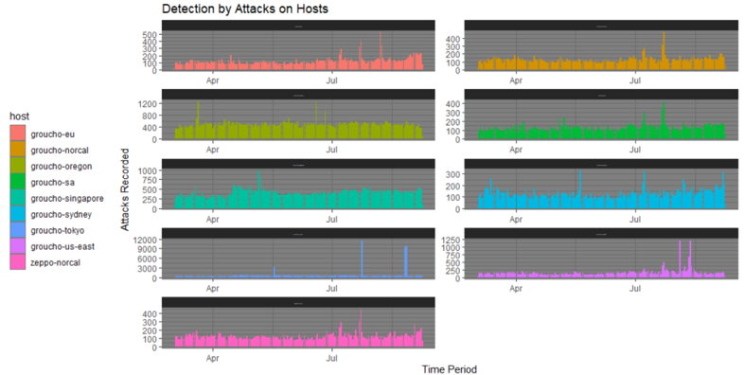
IP Address and Host Overall Behavior

Slide 16
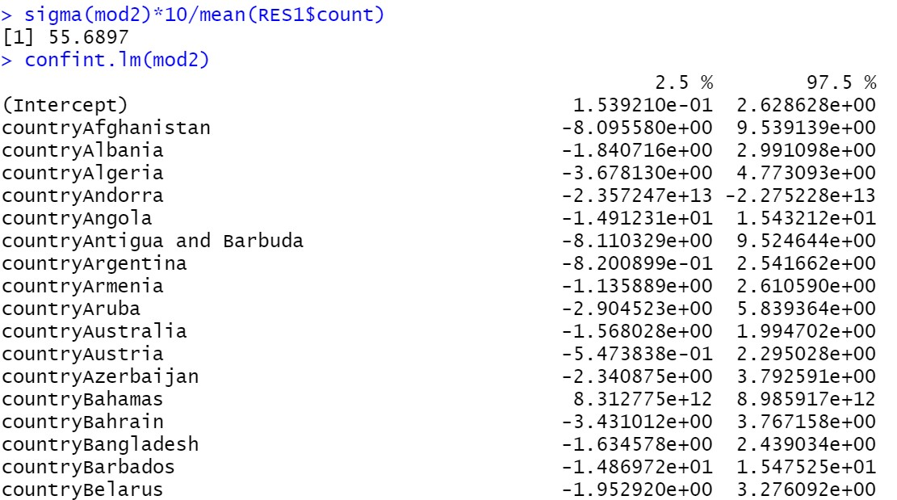
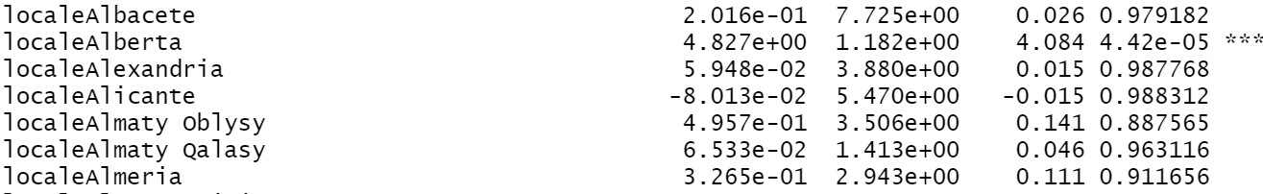
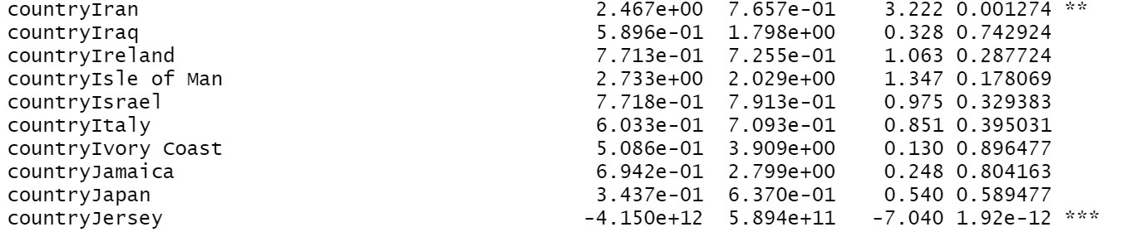
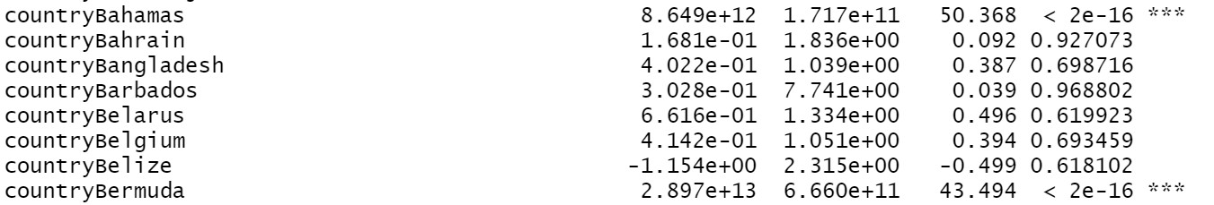
Fitting Models like GLM and LR with significance

Slide 17
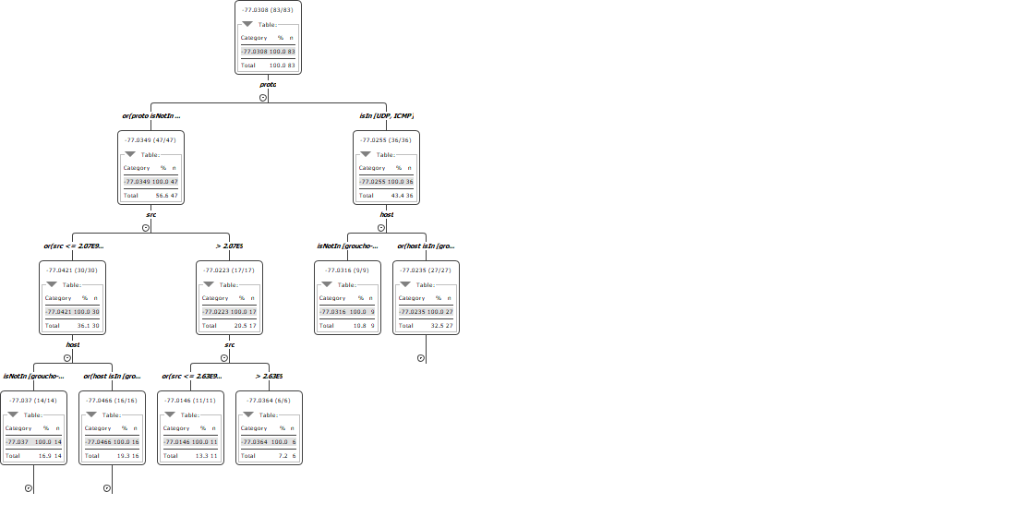
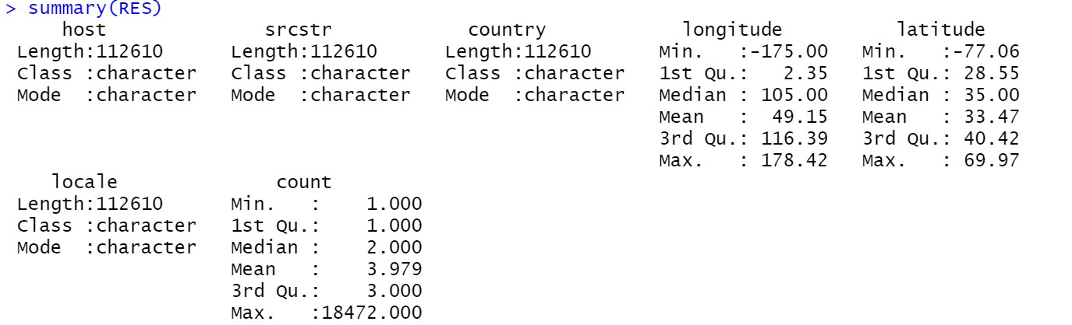
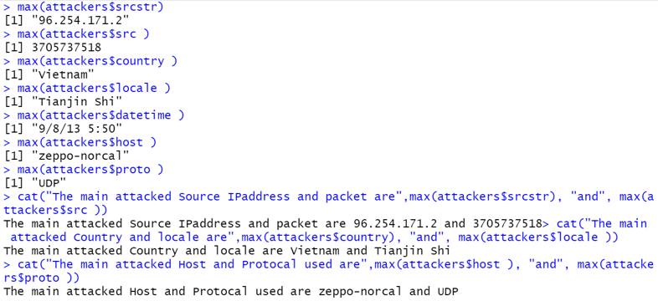
Classification Tree from RF, Results and Statistics

Slide 18
Insights From Visualizations and Analysis
On an overall exploratory data analysis we found these Insights:
Most of the attackers tend to attack during the night-time while the monitoring is idle.
The maximum locale belong to the U.S., Middle East and some parts of Asian countries as map data.
On overall analysis most of the parts that have amazon firms have most crime rate recorded.
It is observed that there are some common IP addresses having common series of attacks and the country of attack is specified.
It is observed that 71% of the attackers used TCP protocol and the top attackers use the UDP protocol.
The summary of the processed data gives the import factors like host significance, time, country analysis, and count of periodic attacks.
The time related analysis and location coordinates gives us the attackers timeline, spatial analysis and the count factor gives us the most attacked occurrences.
The highest predicted values is recorded by random forest other than linear model and logistic regression. The highest accuracy observed by classification tree fit was 85%.

Slide 19
This project focuses on the complexity of the cybersecurity. These analysis and visualizations help to guide the updates and refined modelling of the honeypot’s mechanism and tool. Though the attacks are highly occurring and increasing day-to-day, predictions like the above will help in safeguarding the actual system. The real-time analysis and modelling helps us to take appropriate decisions. In the future work, we can focus more on predicting the attacks on basis of time data and location specific to the IP addresses. It can also be most accurate if the data that has been chosen consists no missing data and include factors like the time taken to break the security barriers, malicious activity. This can be applied to every organisations data and crucial data like federal and military data. Time wise analysis could be made use to predict the future attacks by observing the trends on past recorded attacks.
Conclusion and Future Work

Slide 20
Thank You

